Slide 1
Real-Time Communication
Sathish Gopalakrishnan
Electrical and Computer Engineering
The University of British Columbia

Slide 2
Outline
Real-time communications
Traffic and network models
Properties of networks
Throughput, delay and jitter
Congestion and loss
Examples
Controller area networks
Ethernet

Slide 3
Real-Time Communications
Digital data communications
One would like fast delivery, but not at the expense of reliability
E.g. web browsing, e-mail, file transfer, twitter, etc.
These applications are often referred to as elastic applications
i.e. time can be “dilated”
Real-time data communications
Timely delivery may deemed to be more desirable than reliable delivery
Different levels of priority may be associated with applications
Examples:
Anti-lock braking in a car
“Fly-by-wire” systems in a modern aircraft
Skype internet telephony and IPTV (TV using the Internet Protocol)
drop delayed packets

Slide 4
Real-Time Traffic Categories
Packet-switched traffic falls into two categories:
Synchronous periodic messages
Produced and consumed in a continual basis, according to some schedule
Generally require some performance guarantee
Can be generated by periodic tasks
Fixed rate (“isochronous”) flows (e.g. sensor data, speech)
Characterize by inter-packet spacing, message length, reception deadline
Can be generated by sporadic tasks
Variable rate flows (e.g. MPEG-2 video, control traffic)
Characterize by average throughput + maximum burst size
Aperiodic (asynchronous) messages
No deadline, best-effort delivery, but want to keep delays small
Characterize by average delivery time

Slide 5
Sources of Message Delays
Message delays on networks comprise the following components:
Queuing delay at sender
Network not always ready to accept a packet when it becomes available
Data may be queued if produced faster than the network can deliver it
Queuing delay in the network
Due to cross-traffic or bottleneck links
Network transit time
Fixed propagation delay
Queuing delay at receiver
Application not always ready to accept packets arriving from network
Network may deliver data in bursts

Slide 6
Network Message Delay
Applications
Transport Layer
1
4
Network Interface
Queueing delay at sender
Network
Queueing delay at receiver
2
3
Network transit time
Network queueing delay

Slide 7
Performance Metrics
Throughput: a measure of the number of packets that the network can deliver per unit time
Delay (latency): time taken to deliver a packet
Fixed minimum propagation delay due to speed of light
Variation due to queuing on path
Jitter: Variance of the delay
Buffer requirements: amount of storage required so as not to drop packets
Packet Miss rate: ratio of packets that miss their timing constraints
Packet Loss Rate: ratio of packets that are not delivered
Packet Error Rate: ratio of packets that have an error in them

Slide 8
Throughput, Delay and Jitter
Throughput, delay and jitter vary according to router scheduling techniques.
Possible to derive bounds for delay/jitter for some policies (e.g. RMA, Round-Robin, Weighted Round-Robin techniques)
Network
Tx
Rx
Uniform inter-packet spacing
Non-uniform inter-packet spacing
(some packets delayed more than others)

Slide 9
Jitter and Miss-Rate
Ideal
Distribution
Frequency of Occurrence
Gaussian Distribution
Actual Distribution
Discarded packets due to late arrival
Packet Delay
Minimum network delay
Want to characterize jitter distribution
Hope for something approximating a Gaussian distribution ⇒ simple statistics to derive the miss rate
Fraction of packets lost due to jitter
Actual distribution is more complex

Slide 10
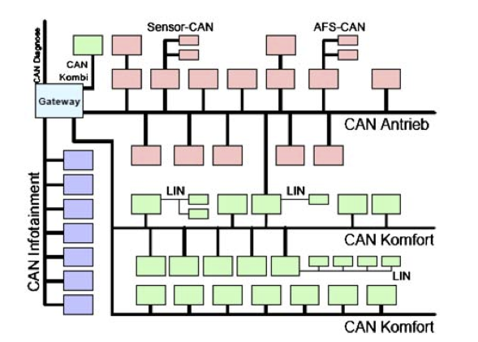
VW Passat Network Architecture
Often we find many different physical / MAC layers within a system…

Slide 11
Congestion and Loss
Both flow characteristics and cross-traffic can cause overloads and congestion, so might the cross traffic
Temporary congestion will cause queuing delays
Persistent congestion will result in queues that stay full, hence packets may be lost
How to avoid this?
Control the amount of traffic at a bottleneck link
Applications need to signal their requirements
Network performs admission control
Or prioritize traffic to give preference to important flows
What scheduling algorithm to use?
Fixed-priority schemes are much easier to implement than dynamic priority schemes
Weighted round-robin techniques are also available
May allow real-time traffic, but discard best-effort data traffic when the network is overloaded

Slide 12
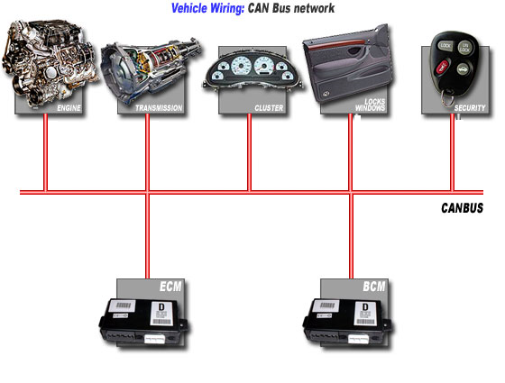
Controller Area Networks (CANbus)
Shared serial bus, send at 1Mbps, maximum bus length is 50m
All stations hear transmissions within a fraction of a bit time
Connections wired AND logic (zero will dominate) logic
Packets start with an ID, then control and data
Widely used in automotive
Finding its way to other areas
ID
Control
Data
Start of packet

Slide 13
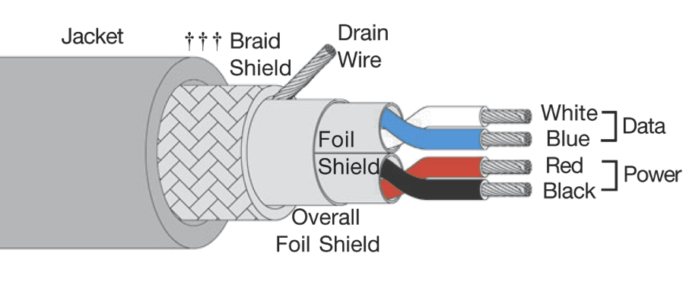
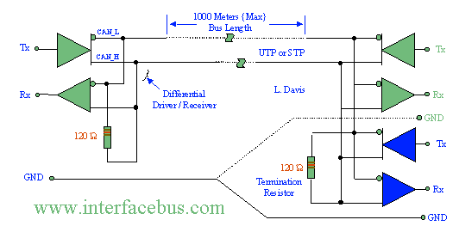
CAN bus: Wiring

Slide 14
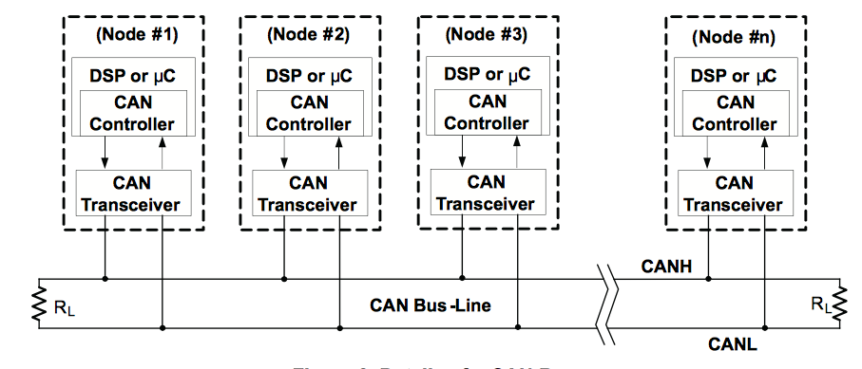
CAN Bus
Bus Guardian
Courtesy of TI sloa101 application note…

Slide 15
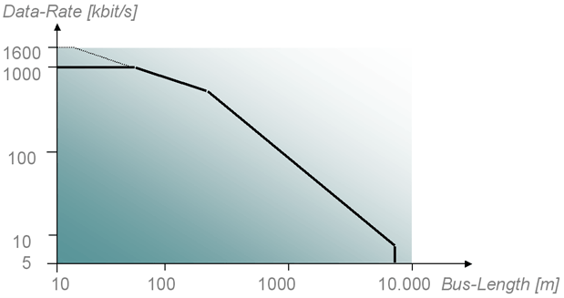
CAN bus: Data Rate vs Distance

Slide 16
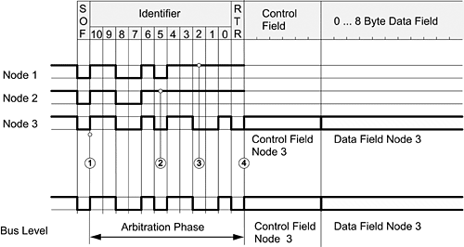
Distributed Priority-based Arbitration
Wait until start of slot, then begin to send with the ID field, but:
Stop if you hear a 0 on the bus when you are sending a 1
Packet with the smallest ID is transmitted first
Priority-based network access
Node 2 Loses
Node 1 Loses

Slide 17
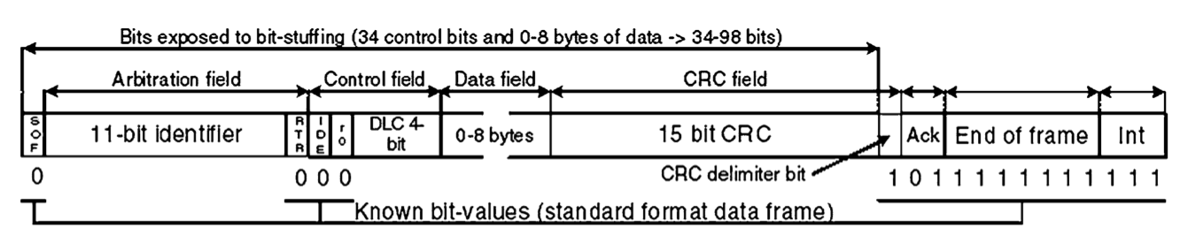
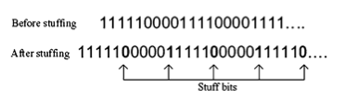
CAN bus: Packets

Slide 18
Real-Time Analysis of CAN
Remember our CPU task model τ_{i} = { C_{i}, T_{i} }
In a communication system:
C_{i} is the message transmission time
T_{i} is the period of the message
What is different as compared to a CPU?
C₁+ B₁ C_{n+} B_{n} 1/ n
-------- + .... + --------- < U(n) = n(2 - 1)
T₁ T_{n}

Slide 19
CAN bus Timing Analysis
Treat messages like priority-based tasks on a processor
Perform RMA analysis
Messages have non-preemptible regions
Adjust by adding blocking factors
Davis, et al “Controller Area Network (CAN) schedulability analysis: Refuted, revisited and revised” RTSJ, 2007

Slide 20
Example: Ethernet
Recall that Ethernet uses CSMA/CD with exponential back off
Before transmitting, check for active link
If not active, try to transmit, listening for collision
If a collision occurs, stop sending, wait before retry
Random binary exponential back-off
After i collisions, back-off by up to 2i slots, randomly chosen
Potentially unbounded delay on busy network
Cannot schedule transmissions to avoid collision
No prioritization of messages
Implications:
Throughput actually drops at high loads
Cannot easily reason about timing properties
Difficult to schedule messages to ensure timely delivery

Slide 21
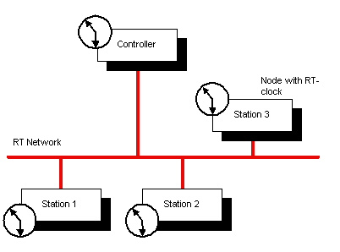
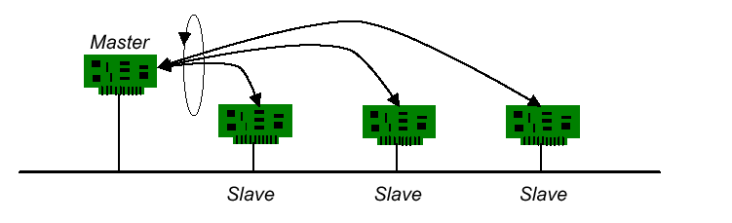
Real-Time Ethernet?
If you have control over ALL nodes in the system
Coordinate using Time Diversity Multiple Access (TDMA)
Synchronize each node (somehow) and assigned a time slot to transmit
Polling TDMA
Synchronized TDMA

Slide 22
Priorities in non-Logical AND networks?
Use transmission delay to act like a priority
Low priority waits longer before it transmits
Dynamic Start
Node 1 (H)
Node 2 (M)
Node 3 (L)
Longer Delay -> Lower Priority

Slide 23
Conclusions
What is real-time communications?
Factors that affect real-time communication
Throughput, delay and jitter
Clock skew
Congestion and loss
Examples of networks and their timing properties
Some networks (like CANbus) provide timing guarantees, others (like the ethernet) do not

